Slide 1
Supporting Indigent Defense Programs During Times of Crisis
July 22, 2020 4:00-5:00 pm ET
Thank you for joining the webinar

Slide 2
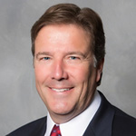
Moderator:
Chris Asplen
Executive Director
National Criminal Justice Association

Slide 3
Questions?
To submit a question please use the Q & A button at the bottom of your screen
There will be a time for questions and answers at the end of the session
You may submit your question at any time
If you would like to communicate with NCJA staff please use the chat feature

Slide 4
Presenters:
Marea Beeman, Director, Research Initiatives, Defender Legal Services, NLADA
Christian Kervick, Executive Director, DE Criminal Justice Council
Stephen Hattori, Executive Director, GU Public Defender Service
Cathleen L.G. Moylan, Program Coordinator IV, GU Public Defender Service
Jonathan Sacks, Director, MI State Appellate Defender Office and Criminal Defense Resource Center

Slide 5
Byrne JAG Funds and CESF: Supporting Indigent Defense Programs During Times of Crisis
The Guam Public Defender Service Corporation:
Building Awareness of Indigent Defense as a Priority

Slide 6
NLADA’s Accessing Resources for Public Defenders
Accessing Federal Grants, Foundation Funds and Other Supplemental Resources (New Guide)
Byrne/JAG Grants
Coronavirus Emergency Supplemental Funding (CESF) Program
Make Your SAA Your Best Friend

Slide 7
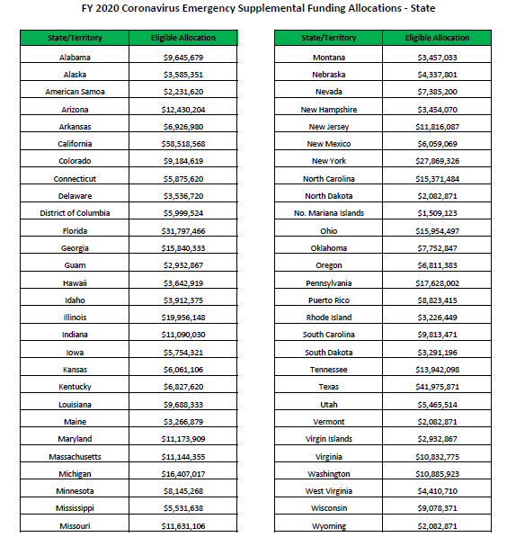

Slide 8
Guam’s CESF Program
Guam application
PPE, sanitization supplies, ambulances, nurse practitioner
PDSC request
Video conferencing equipment, mobile internet access, PPE, laptops
SAA response and assistance

Slide 9
Byrne/JAG
PDSC video conferencing technology proposal
PDSC Public Comments Re: FY 2020 Guam Edward Byrne JAG Program
NLADA’s article: “Prioritizing Indigent Defense”
NCJA’s article: “How States Invest Byrne JAG in Public Defense.”

Slide 10
Thank You
Guam Public Defender Service Corporation
779 Route 4
Sinajana, Guam 96910
Website: www.guampdsc.net

Slide 11
Q & A
Moderator:
Chris Asplen National Criminal Justice Association
Presenters:
Marea Beeman, Director, Research Initiatives, Defender Legal Services, NLADA
Christian Kervick, Executive Director, DE Criminal Justice Council
Stephen Hattori, Executive Director, GU Public Defender Service
Cathleen L.G. Moylan, Program Coordinator IV, GU Public Defender Service
Jonathan Sacks, Director, MI State Appellate Defender Office and Criminal Defense Resource Center

Slide 12
Thank You For Joining Us!
NCJA Resources:
NCJA COVID-19 Resources: https://www.ncja.org/covid-19-resources
NCJA CESF Primer Webinar: https://www.youtube.com/watch?v=lrph0uM09W4
To learn more about the Byrne JAG Program please check out the Byrne JAG section of our website: https://www.ncja.org/investing-byrne-jag
To find the SAA in your state please visit our directory: https://www.ncja.org/agency-directory
NLADA Resources
Time Sensitive Information for Defender Organizations About Federal Resources Available NOW to Assist Defender Agencies in Coronavirus Response – Information about emergency federal resources made available through the CARES Act to assist in coronavirus response
Accessing Federal Funds for State and Local Criminal Justice Activities: The Edward Byrne Memorial Justice Assistance Grant (JAG) Program – Information about annually issued, federal formula grant program for justice activities
Accessing Federal Grants, Foundation Funds and Other Supplemental Resources: A Toolkit for Public Defenders – Report with strategies for planning and funding successful projects
This webinar series is supported by Grant No. 2019-YA-BX-K002 awarded by the Bureau of Justice Assistance. The Bureau of Justice Assistance is a component of the Office of Justice Programs, which also includes the Bureau of Justice Statistics, the National Institute of Justice, the Office of Juvenile Justice and Delinquency Prevention, the SMART Office, and the Office for Victims of Crime. Points of view or opinions are those of the speakers.

